Slide 1
Kaldor and Piketty’s Facts: The Rise of Monopoly Power in the US
Gauti Eggertsson
Jacob Robbins
Ella Getz Wold
Brown University

Slide 2
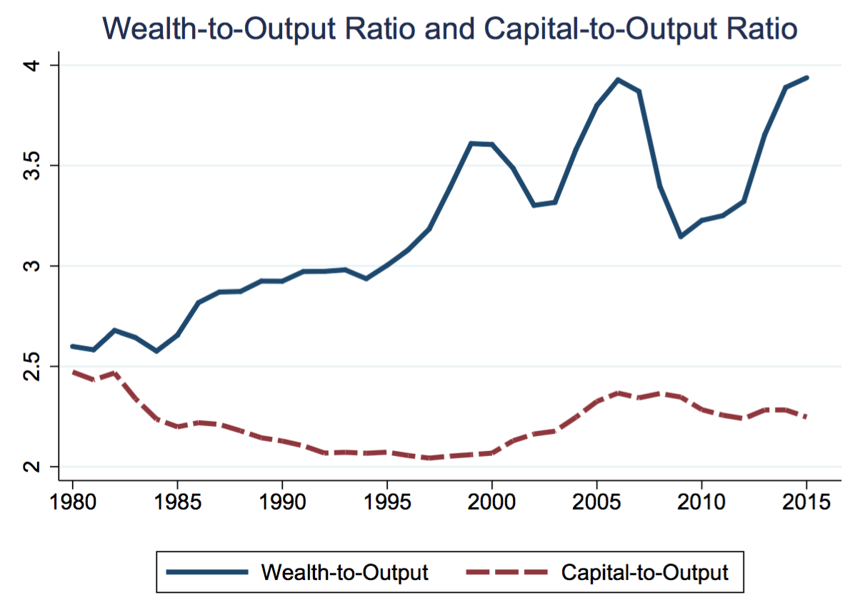
(P1) “Wealth is back”
Distribution National Accounts
Piketty, Saez and Zucman (2017)
BEA
Puzzle 1: Should be same in neoclassical model

Slide 3
(P1) Wealth accumulation
Wealth is not embodied in new productive capital goods. Replacement value of capital to output has stagnated.
Instead, wealth was accumulated through capital gains.
Neoclassical model
Wealth cannot diverge from capital
Wealth is accumulated by savings

Slide 4
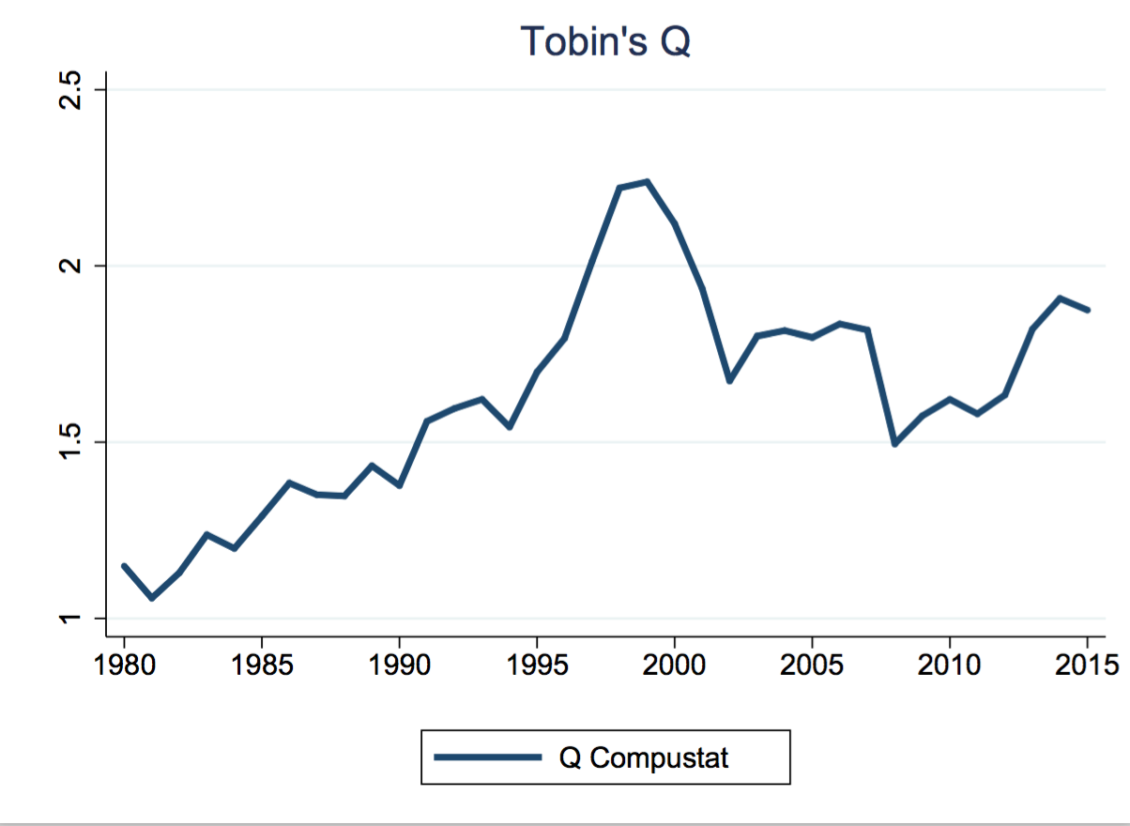
(P2) Tobin’s Q
Microdata:
Compustat
microdata
$$Q=\frac{Market value of installed capital}{Replacement cost of capital}$$
Puzzle 2: Should be 1 in long run in neoclassical model

Slide 5
(P2) Tobin’s Q
“The increase in stock brings market value into line with replacement costs, lowering the former and/or raising the latter”
Tobin and Brainhard (1976)
Standard neoclassical models predict that the value of Tobin’s Q should be 1 in long run

Slide 6
(P3) Decrease in real interest rate while measured return on capital constant
$$R=\frac{Y−wL−δK}{K}$$
Gomme, Ravikumar, and Rupert (2011), NIPA
Puzzle 3: GRR and r should be same in neoclassical model
AND stable – one of Kaldor’s stylized facts

Slide 7
(P3) Decrease in real interest rate while measured return on capital constant
In neoclassical model the average return is equal to the interest rate.

Slide 8
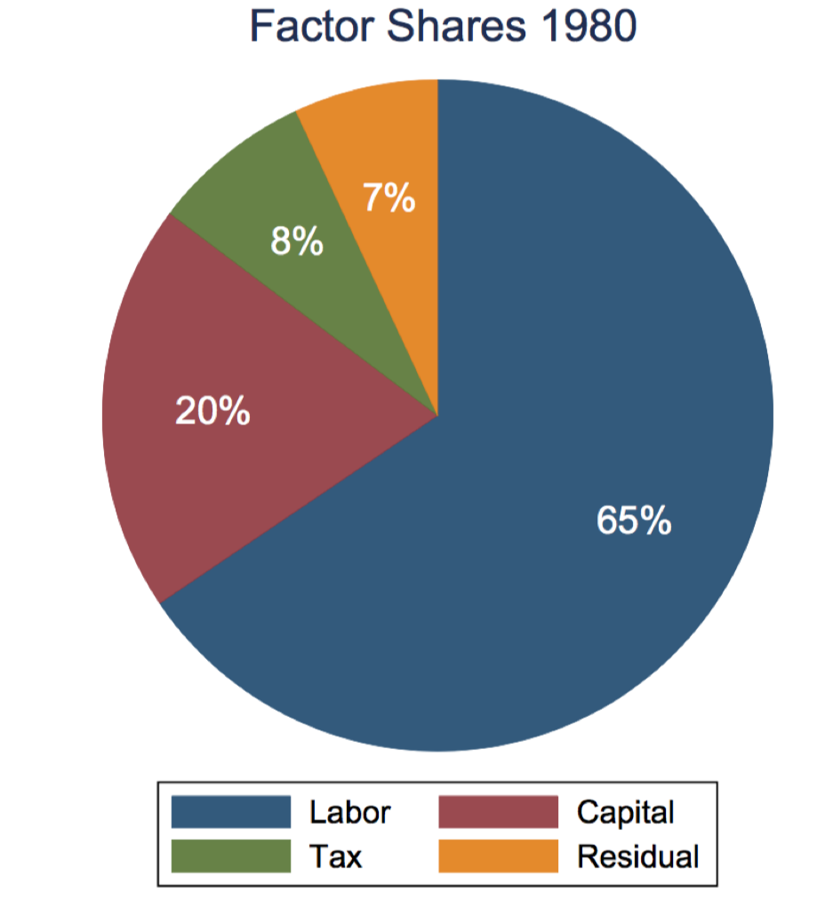
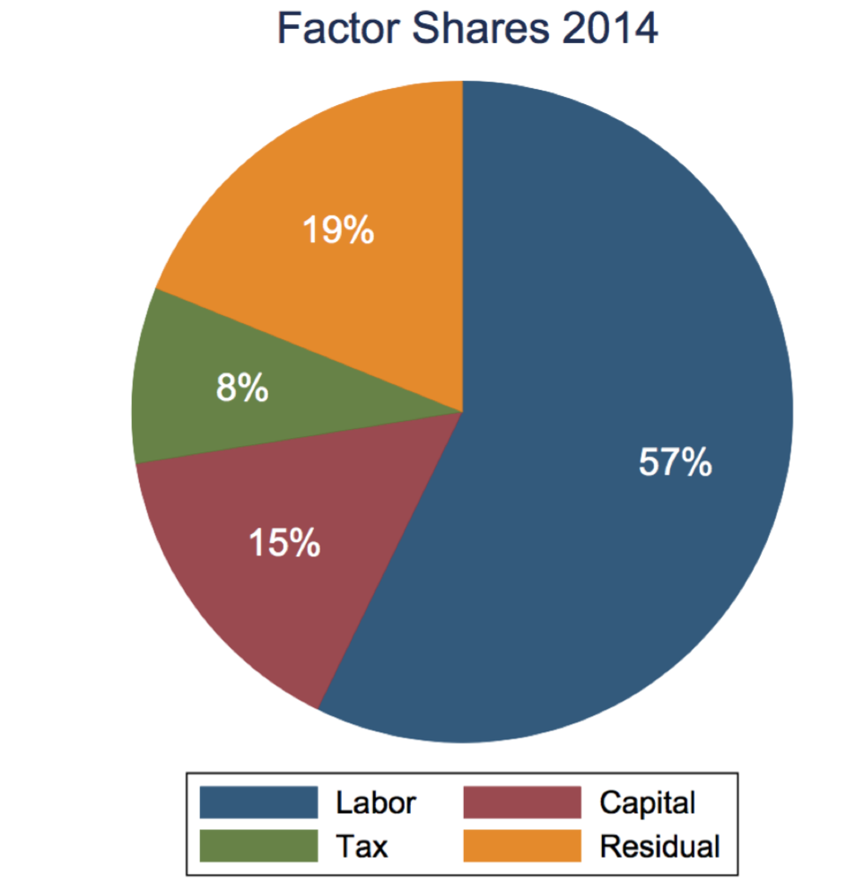
(P4) A persistent decrease in labor and capital share….
Puzzle 4: Should be constant in neoclassical model – one of Kaldor’s stylized facts

Slide 9
(P4) A persistent decrease in labor and capital share….
In the neoclassical model, there is no residual factor share.

Slide 10
(5) Decrease in investment-to-output ratio, even given low borriwng costs and high Tobin‘s Q
Philippon and Gutierrez (2017)
Puzzle 5: Should by rising given P2 and P3

Slide 11
(5) Decrease in investment, despite low interest rates and high Tobinds Q
Why is investment not exploding given low interest rate?
High Q?

Slide 12
Summing up
(P1) W/Y>> despite low S and low K/Y.
(P2) High Tobin’s Q >> 1.
(P3) A decrease in r while measured return on capital constant.
(P4) A decrease in both the labor share and the capital share.
(P5) A decrease in I/Y despite low r and a high Q.

Slide 13
Resolution of Puzzles
Hypothesis: P1-P5 are being driven by two underlying trends:
An increase in monopoly power and markups
A decline in the natural rate of interest

Slide 14
Why them?
Fall in real interest rates: Fact
Market Power
Concentration measures
Firm entry
Markup measures
Macro
Micro

Slide 15
Concentration Increasing
H=$\sum_{i=1}^{N}{s_{i}^{2}}$
Common ownership
correction (Compustat, Guiterrez and Phillipon (2017)

Slide 16
Revenue shares of largest firms increasing
US Census

Slide 17
Firm Entry Rates Declining
Business Dynamics Statistics,
Karahan, Pugsley and Sahin (2018)

Slide 18
New Keynesian measures of markups

Slide 19
Using profit share
Barkai (2016),
Neiman and Karabarboulis (2018)

Slide 20
Estimates from Loecker and Eechout (2017)
Compustat

Slide 21
Traina (2018)
Main difference:
Takes into account marketing and managerial costs

Slide 22
Select lit review Standing on sholders of….
Build on large literature. About 70 references already and counting
P1: Piketty, Saez and Zucman (2018), Stiglitz (2016) …
P2 : Philippon and Gutierrez (2016) …
P3: Caballero, Farhi, Gourinchas (2017), Gomme, Ravikumar and Rupert (2015), Elsby, Hobijin and Sahin (2013) …
P4: Barkai (2016), Caballero, Farhi, Gourinchas (2017), Karbarabounis and Neiman (2014)…
P5: Phillipon and Gutierres (2016), Barkai (2016) …
Markups: Autor et al (2017), De Loecker and Eechout (2017), Hall (2018), Traina (2018) ….
Falling Real Rates: Del Negro et al (2017), Eggertsson, Mehrotra and Robbins (2017), Gagnon, Johannsen, Lopez-Salido (2016) ….

Slide 23
Outline
Five puzzles - “stylized facts” and why neoclassical model does not account for them.
Key hypothesis for resolution
Increase in monopoly power
Secular reduction in real interest rates
A minimalistic modification of the canonical neoclassical model
Qualitative Resolution in model
Quantitative Resolution in model
Estimation of driving forces
Calibration exercise
Extension

Slide 24
Household preferences
Unit mass of individuals with Epstein-Zin utility:

Slide 25
Model – focus on production
Final good composite
Demand of final good i
Production function
of final firm i

Slide 26
Final goods firms
Final goods charge optimal markup
Markups follow AR(1) process
Barriers to entry generate pure profits
$$μ_{t}=\frac{Λ_{t}}{Λ_{t}−1}$$

Slide 27
Firm dynamics
Although barriers, not “permanent”
Firm exit a la Melitz (2003). Each period, a final goods firm i has a probability Δ of exiting
Entry is also exogenous – each period, mass Δ of new final goods firms enters.

Slide 28
Asset pricing
There are security markets in which the rights to the future profits of final goods firms are bought and sold
Securities S_{t+1} are traded at time t with price $X_{t}^{f}.$
For entering firms, shares distributed to individuals as ‘IPO Securities’
$$X_{t}^{f}=E_{t}\sum_{j=1}^{∞}{{{(1−∆)}_{}^{j−1}m}_{t+j}d_{t+j}^{f}}$$

Slide 29
Intermediate goods firms
Representative firm
Adjustment costs as in Jermann (1998)

Slide 30
Long run risk
Long-run productivity risk enters our model as in Bansal and Yaron (2004) and Croce (2014)
Will allow us to match equity premium

Slide 31
Wealth and Tobin’s Q
Define aggregate wealth as the total market value of physical capital and securities
Empirical Tobin’s Q is defined as
Note that the existence of securitized pure profits allows there to be a wedge between wealth and capital, and allows Tobin’s Q to be permanently above one
$$W_{t}=X_{t}^{f}+X_{t}^{i}=X_{t}^{f}+q_{t}^{}K_{t}^{}$$
$$Q_{t}={\frac{W_{t}}{K_{t}^{}}=\frac{X_{t}^{f}+q_{t}^{}K_{t}^{}}{K_{t}^{}}}_{}^{}$$

Slide 32
Outline
Five puzzles - “stylized facts” and why neoclassical model does not account for them.
Key hypothesis for resolution
Increase in monopoly power
Secular reduction in real interest rates
A minimalistic modification of the canonical neoclassical model
Qualitative Resolution in model
Quantitative Resolution in model
Estimation of driving forces
Calibration exercise

Slide 33
Qualitative Resolution
Consider first steady state of the model as a constant solution without uncertainty
Can solve for P1-P5 qualitatively.
But will not be able to speak to evolution of some financial variables like average returns that include risk premia precluding a serious quantitative evaluation.

Slide 34
P1
$$\frac{W}{Y}=\frac{X^{f}+X^{i}}{Y}=\frac{X^{f}}{Y}+\frac{K}{Y}$$
$$\frac{\frac{μ−1}{μ}}{1+r−\left(1−Δ\right)e^{ξ}}$$
$$\frac{\frac{α}{μ}}{r+δ}$$
$μ↑X/Y↑$, $r↓X/Y↑$
$μ↑K/Y↓$, $r↓K/Y↑$

Slide 35
P2
$$Q=\frac{W}{K}=\frac{X^{f}+X^{i}}{K}=\frac{X^{f}}{K}∗\frac{K}{Y}+1$$
$$\frac{(μ−1)α^{−1}(r+δ)}{1+r−\left(1−Δ\right)e^{ξ}}$$
$μ↑Q↑$, $r↓Q?$

Slide 36
P3
$$AR=\frac{Y−wL−δK}{K}=r+\frac{\frac{μ−1}{μ}}{K/Y}=r+\frac{μ−1}{α}(r+δ)$$
$μ↑AR↑$, $r↓AR↓$

Slide 37
P4
$$\frac{r+δ}{K}=\frac{1}{μ}(1−α)$$
$$μ↑\frac{r+δ}{K}↓\frac{wL}{L}↓$$
$$\frac{wL}{L}=\frac{1}{μ}α$$

Slide 38
P5
$$\frac{I}{Y}=\frac{α(δ+ε^{ζ}−1)}{μ(r+δ)}α$$
$$μ↑\frac{I}{Y}↓,r↓\frac{I}{Y}↓$$

Slide 40
Can we match puzzles?-- simple model
$$δ=0.06$$
$$α=0.23$$
$$Δ=0.21$$
$Δ,δ$, $α$, $μ,\text{r}$, $e^{ξ}$
2.6 (2.54)
0.7 (0.71)
0.18 (0.17)
0.07 (0.12)
1.18 (1.14)
r=3%
r=1%
$μ$=1.1
$μ$=1.22
3.39 (3.63)
0.63 (0.64)
0.17 (0.16)
0.08 (0.13)
1.32 (1.74)

Slide 41
Outline
Five puzzles - “stylized facts” and why neoclassical model does not account for them.
Key hypothesis for resolution
Increase in monopoly power
Secular reduction in real interest rates
A minimalistic modification of the canonical neoclassical model
Qualitative Resolution in model
Quantitative Resolution in model
Estimation of driving forces
Calibration exercise
Extensions

Slide 42
Quantitative Analysis
We’ve seen how an increase in monopoly power combined with a decrease in r can potentially account for the five facts
But are these effects quantitatively important?

Slide 43
Quantitative experiment
Do a second order approximation of the model.
Calibrate the model to 1970.
Then “plug in”
Change in markups from 1970 level to 2015 level
Changes in interest rates from 1970 to 2015 level
Compare changes in model moments to changes in data moments, see if we can match the puzzles

Slide 44
Quantitative Exercise
3 categories categories of parameters and shocks
1. Levels of markups and interest rates 2. Parameters from data and literature
3. Parameters chosen to match 1970 data moments, through minimization of objective function

Slide 45
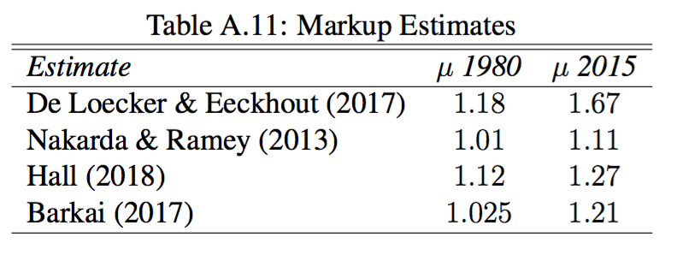
(1) Markups
Our estimate: Using methods similar to Barkai, find increase from 1.11 to 1.22 from 1970-2015

Slide 46
(1) Changes in the natural rate
Our estimate: Decline of 2%, from 3% in 1970 to 1% in 2015

Slide 47
(2) Parameters taken from the literature

Slide 48
(3) Parameters calibrated to 1970 moments

Slide 49
(3) Parameters calibrated to 1970 moments

Slide 50
Calibration
Note that we are choosing parameters to match only 1970 moments
In particular, we do not choose any parameters to match 2015 moments, or to try and match any change in the moments from 1970 to 2015
The success or failure of the exercise will be comparing changes in our model moments to change in the data moments

Slide 51
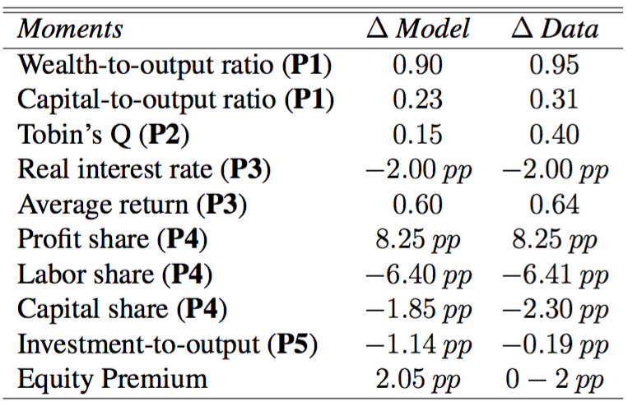
Results – Markups & Interest Rates

Slide 52
Results
Overall the markups and drop in real interest rate can “quantitatively account” for P1-P5

Slide 53
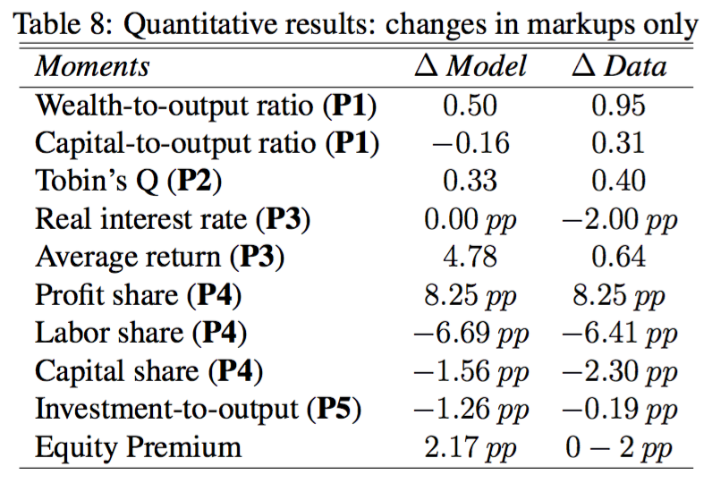
Results – markup only

Slide 54
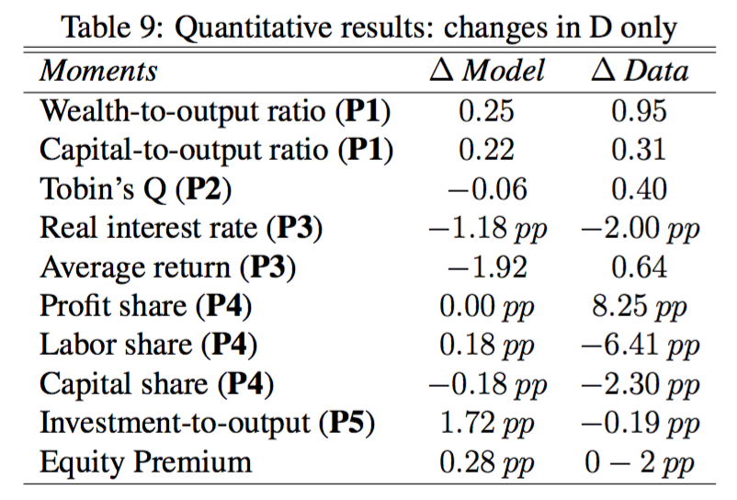
Results – interest rate only

Slide 55
Other estimate of markups
Using Nakarda-Ramey yields very similar results
De Loecker and Eeckout (2017)

Slide 57
Other stories, extensions
Housing to be added
Fall in relative price of investment to be added.
Implausible implications for other shocks?
Other candidates
Rise in risk-premia
in our case it is endogenous
Intangible capital
What about pre-1970?
Endogenous rise in markups

Slide 58
Intangible capital story
Another story --- there is a still a large stock of unmeasured intangible capital
This would lead to a high measured Q, average return, and W/Y…..

Slide 59
However…
Last two revisions to NIPAs have included massive revisions of intangible capital
Most expenditures on R&D, software, training, etc are now counted as investment
What potential intangible investment is missing? Advertising, marketing (Traina 2018), etc.
But is this investment? ”creates” market power

Slide 60
Story 1960-1980: P1

Slide 61
Story 1960-1980: P2

Slide 62
Story 1960-1980: P3

Slide 63
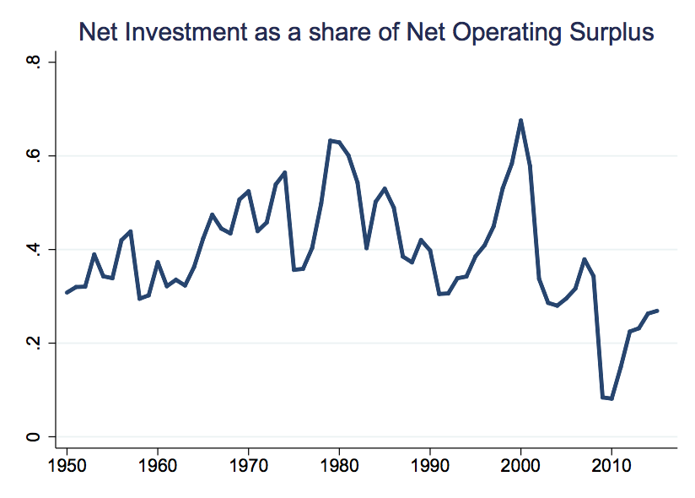
Story 1950-1980: P4

Slide 64
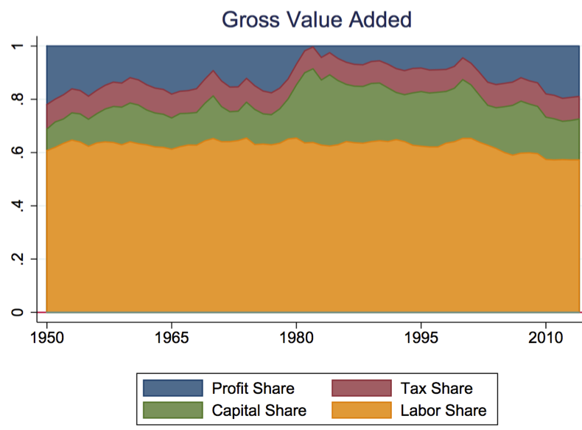
Story 1960-1980: P5

Slide 65
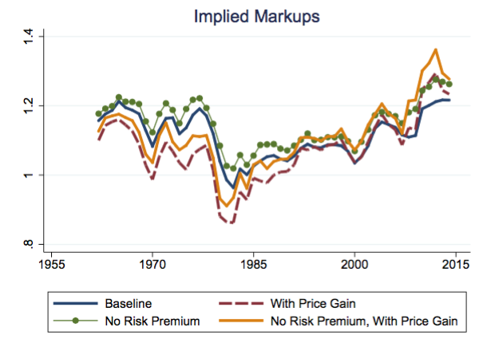
Story 1950-1980: Markups

Slide 66
Can we match puzzles?-- simple model
$$δ=0.06$$
$$α=0.23$$
$$Δ=0.21$$
$Δ,δ$, $α$, $μ,\text{r}$, $e^{ξ}$
2.6 (2.54)
0.7 (0.71)
0.18 (0.17)
0.07 (0.12)
1.18 (1.14)
r=3%
r=2%
$μ$=1.1
$μ$=1.15
3 (2.8)
0.66 (0.63)
0.19(0.16)
0.08 (0.15)
1.28(1.64)

Slide 67
Pre 1980 Story
Overall story consistent with a moderate level of markups in 1960, followed by a decline until 1980, followed by a significant increase

Slide 68
Firm Entry Rates Declining: Endogenous markups
Atkeson-Burstein (2008)
Jaimovich and Floetotto (2008)
Countinum of industries on measure 0 to 1.
Finite number of firms in industry
Berntrand competition.
Simples case: Elasticity across industries 1, then
N down by 20%
$μ$ from 1.4 to 1.5

Slide 69
Conclusion
P1-P5 → circumstantial evidence for higher markups
To early to draw policy conclusions
Needed: Explicit model where the monopoly “wedge” is explicitly modeled.
Malignant development
(less antitrust!)
Higher
markups
Benevolent
(R&D gives rise to temporary advantages that are efficient

Slide 70
Conclusion
Analysis relies heavily on estimates of markups, which are difficult to measure. Having said that, an increase in markups should lead to…
Negative impact on GDP growth
Increase in income inequality and wealth inequality
Important implications for capital taxation?

Slide 71
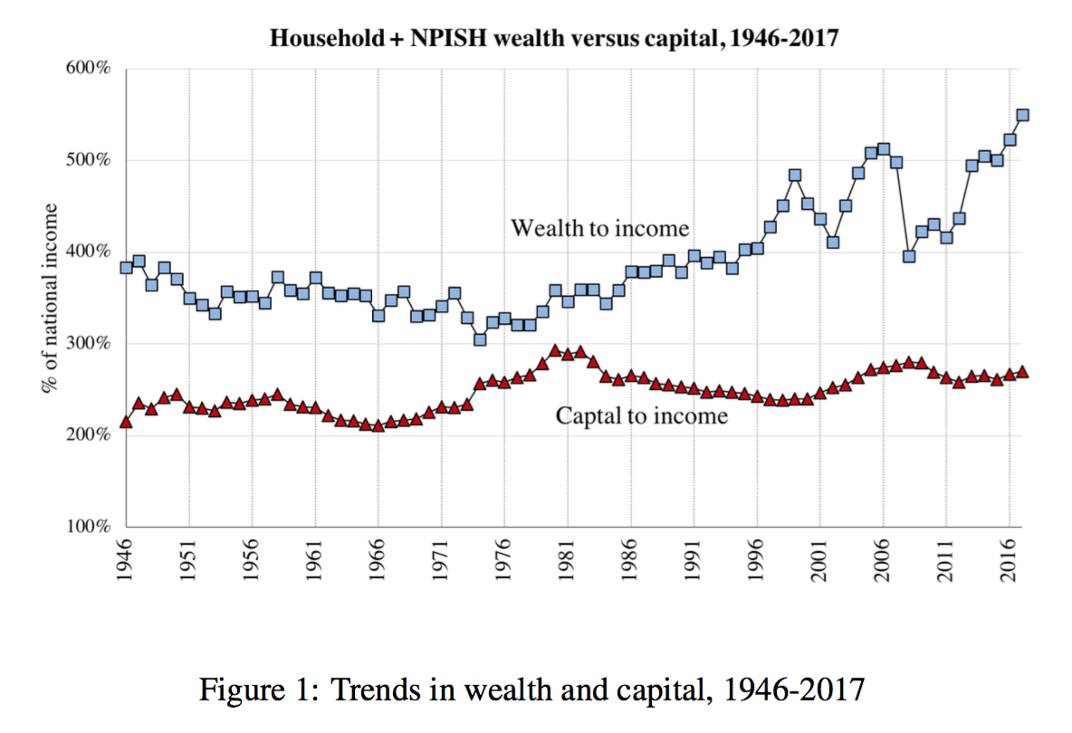
Back to fact 1

Slide 72
Gross national capital gain
Definition: A pure capital gain is the aggregate increase in the market value of household wealth beyond what is saved.

Slide 73
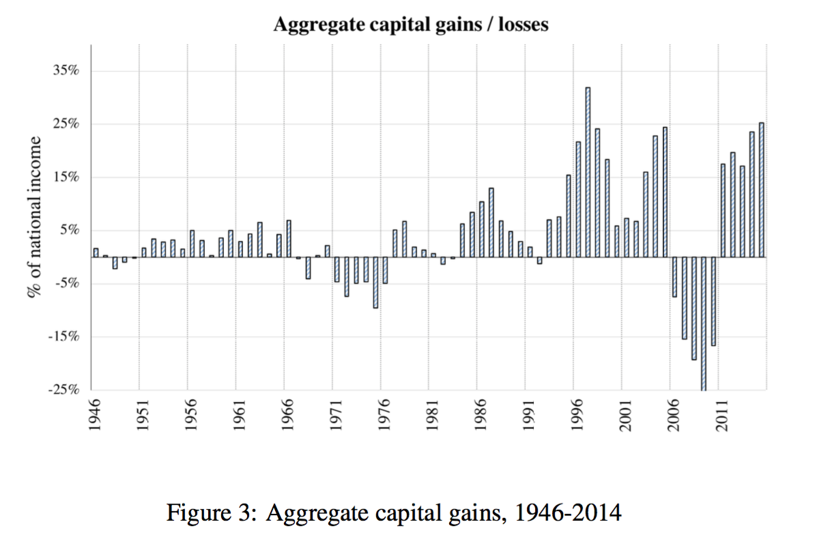
Gross National Capital Gains

Slide 74
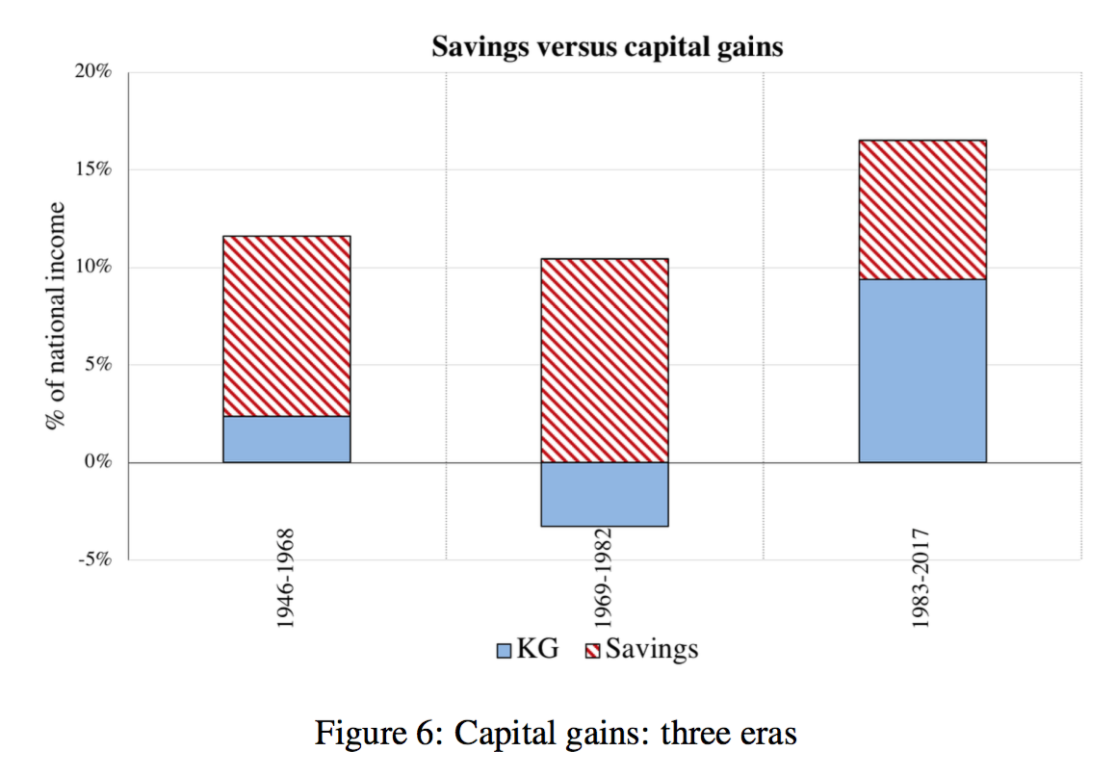
Gross National Capital Gains

Slide 75
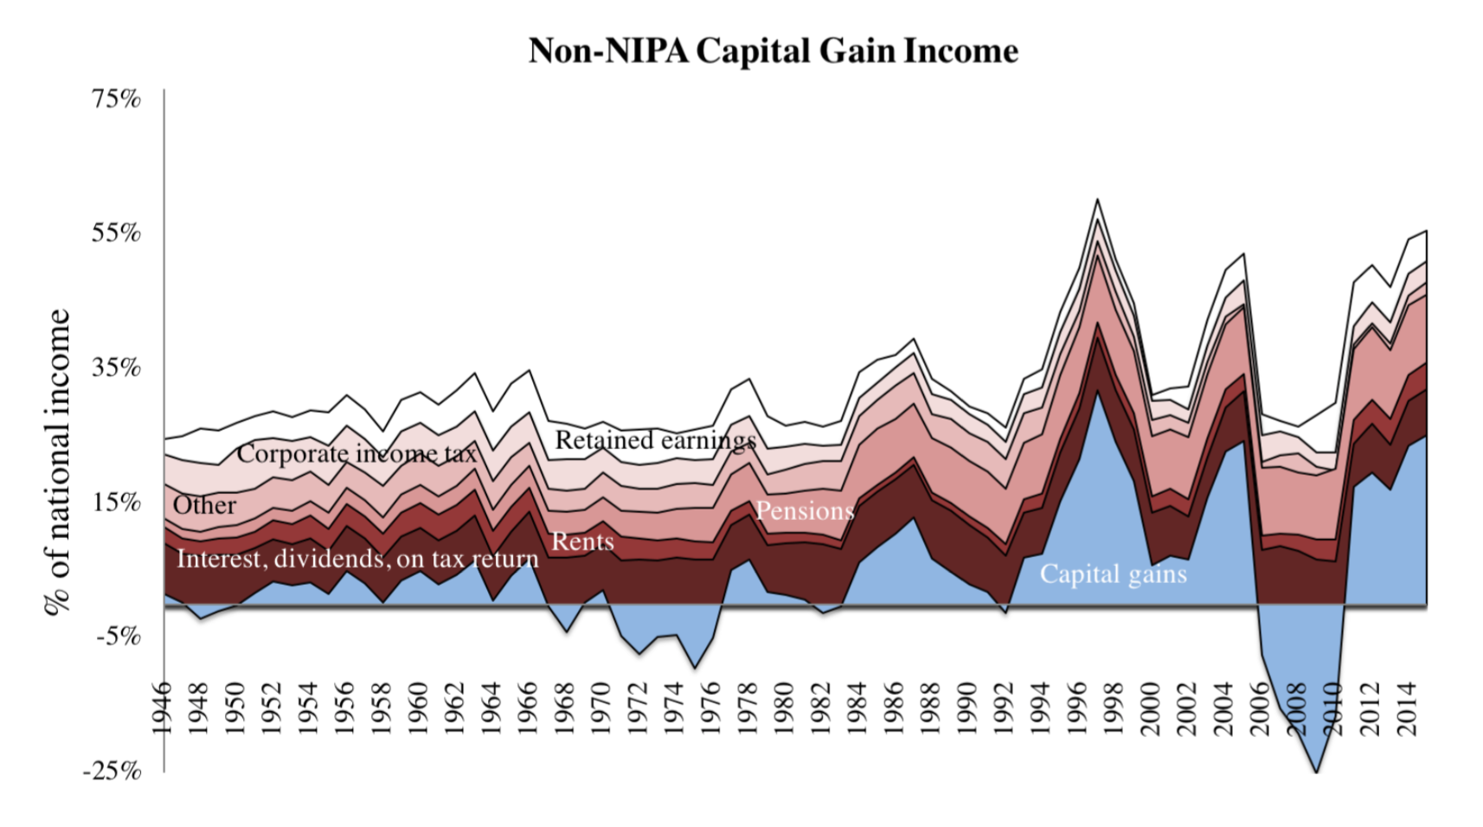
Distribution of capital gains

Slide 76
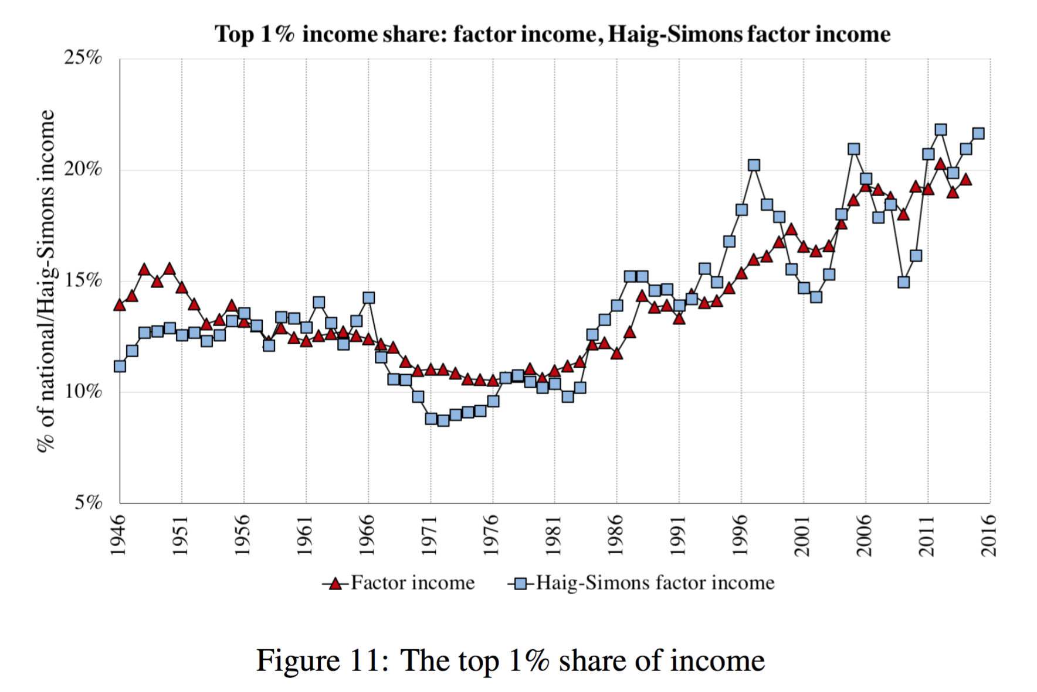
Effect on top income shares

Slide 77
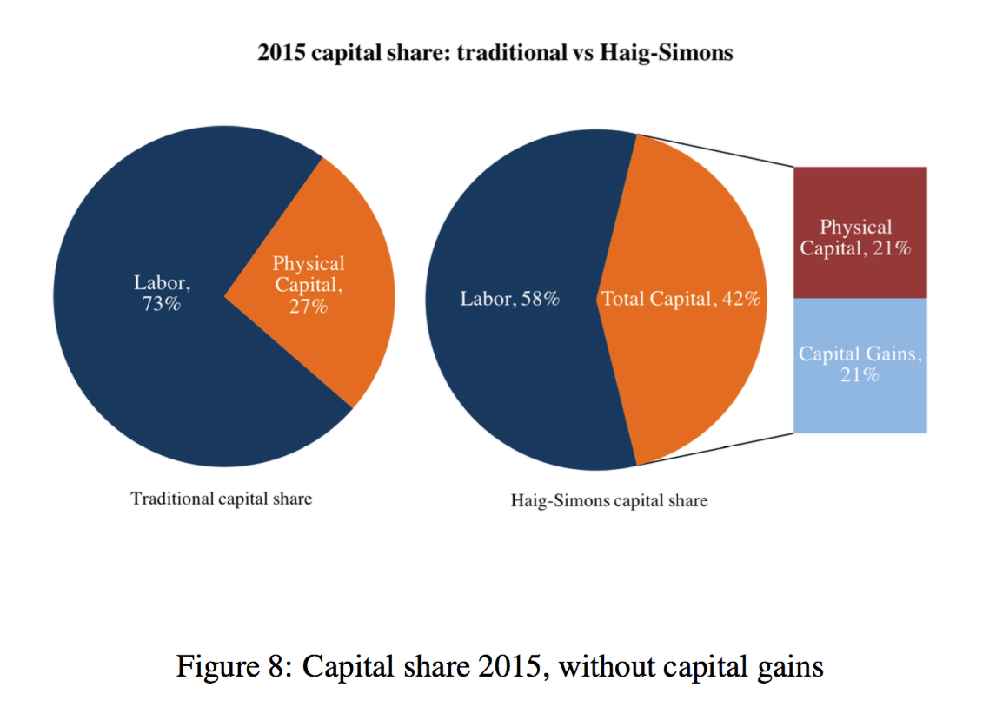
Effect on top income shares

Slide 78
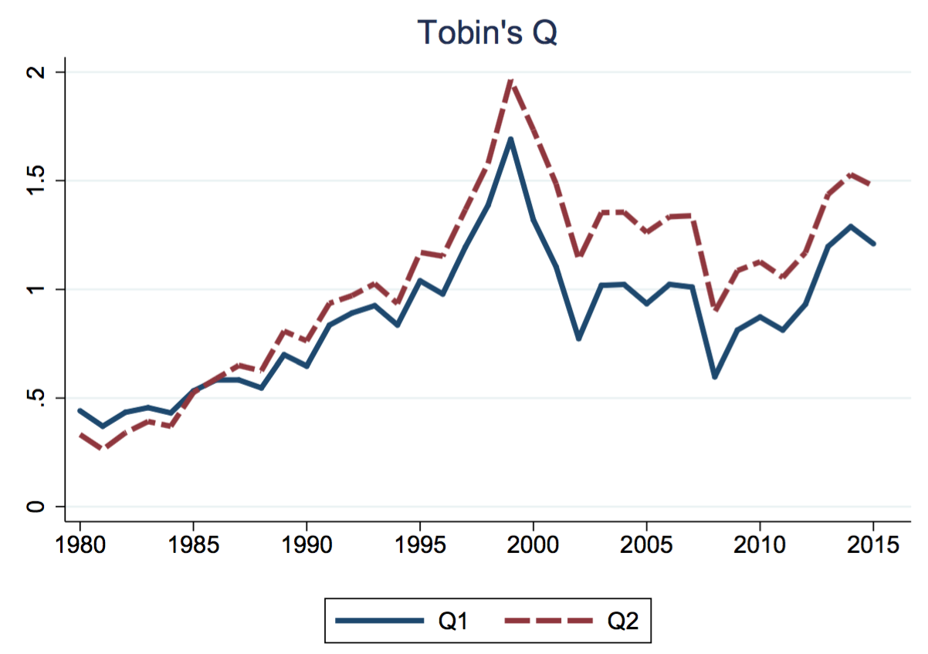
(P2) Macro Tobin’s Q
Macrodata:
Flow of Funds by Fed
Bob Hall (2001)
Philippon and Gutierrez (2017)
$$Q=\frac{Market value of installed capital}{Replacement cost of capital}$$

Slide 79
Change in Revenue Share

